Slide 1
10 Questions about the Birth of Christ
CrackaBible.com

Slide 2
#1 All 4 Gospels tell the story of Jesus' birth
False

Slide 3
#2 The angel Gabriel appeared to Joseph to inform him that Mary was with child.
False

Slide 4
#3 A bright star appeared in the sky and led the shepherds to a manger.
False

Slide 5
#4 A bright star appeared in the sky and led the wise men to the manger.
False

Slide 6
#5 John the Baptist was born at the same time as Jesus.
False

Slide 7
#6 Jesus was born in Nazareth.
False

Slide 8
#7 An inn keeper told Joseph there was no room in the inn.
False

Slide 9
#8 Jesus was born in a barn/stable because there was no room in the Inn.
False

Slide 10
#8 Jesus was born in a barn/stable because there was no room in the Inn.
Luke 2: 4-7
  Where did this idea of a stable/barn come from?
    Manger
  INN: All translations except for a few say this word. The NIV and Youngs say Guest House
  Katalyma
  Pandocheion (Pan-dokk-ion) – “All” and “To Receive”

Slide 11
#8 Jesus was born in a barn/stable because there was no room in the Inn.
2 room homes
  Family Room and a Guest Room
    2 doors in the front of the house
    Prophet’s Chamber – 1 Kings 17:19

Slide 12
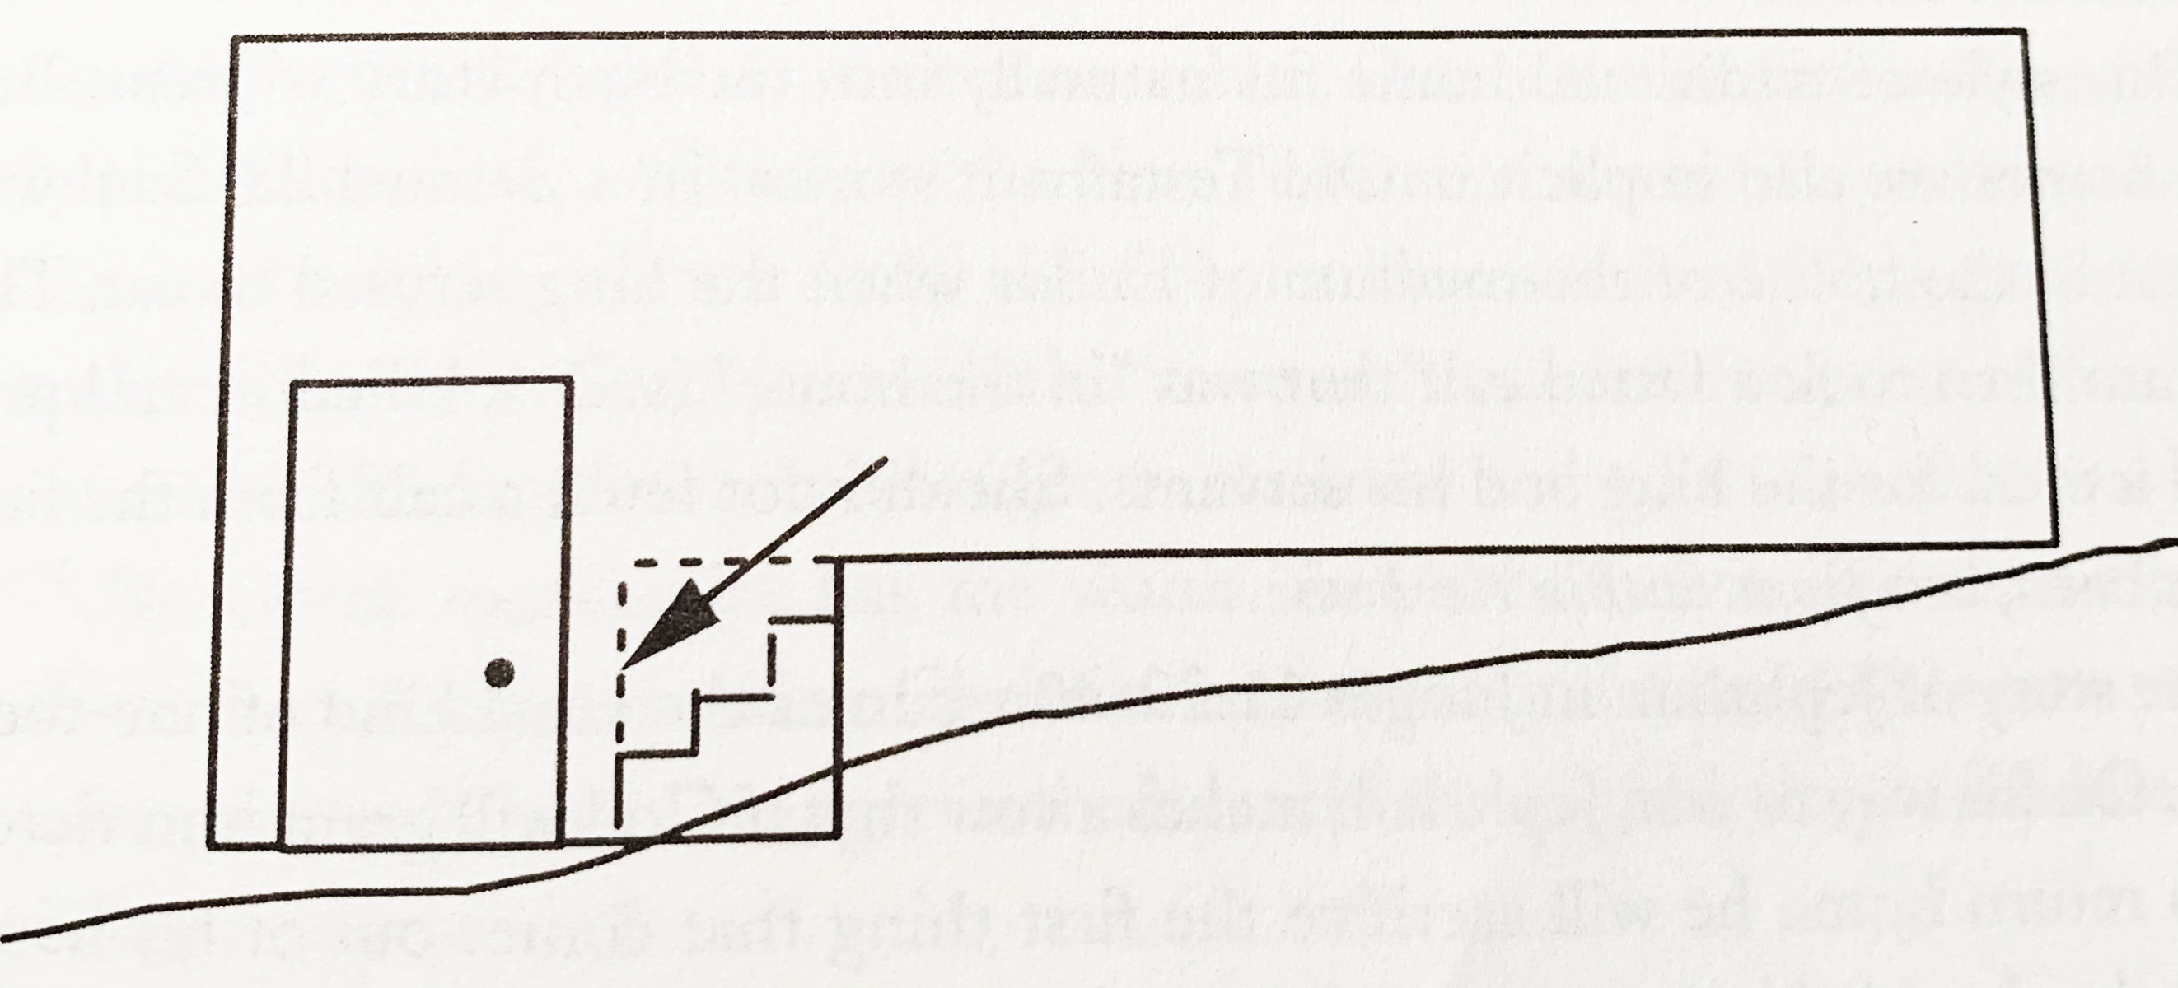
#8 Jesus was born in a barn/stable because there was no room in the Inn.

Slide 13
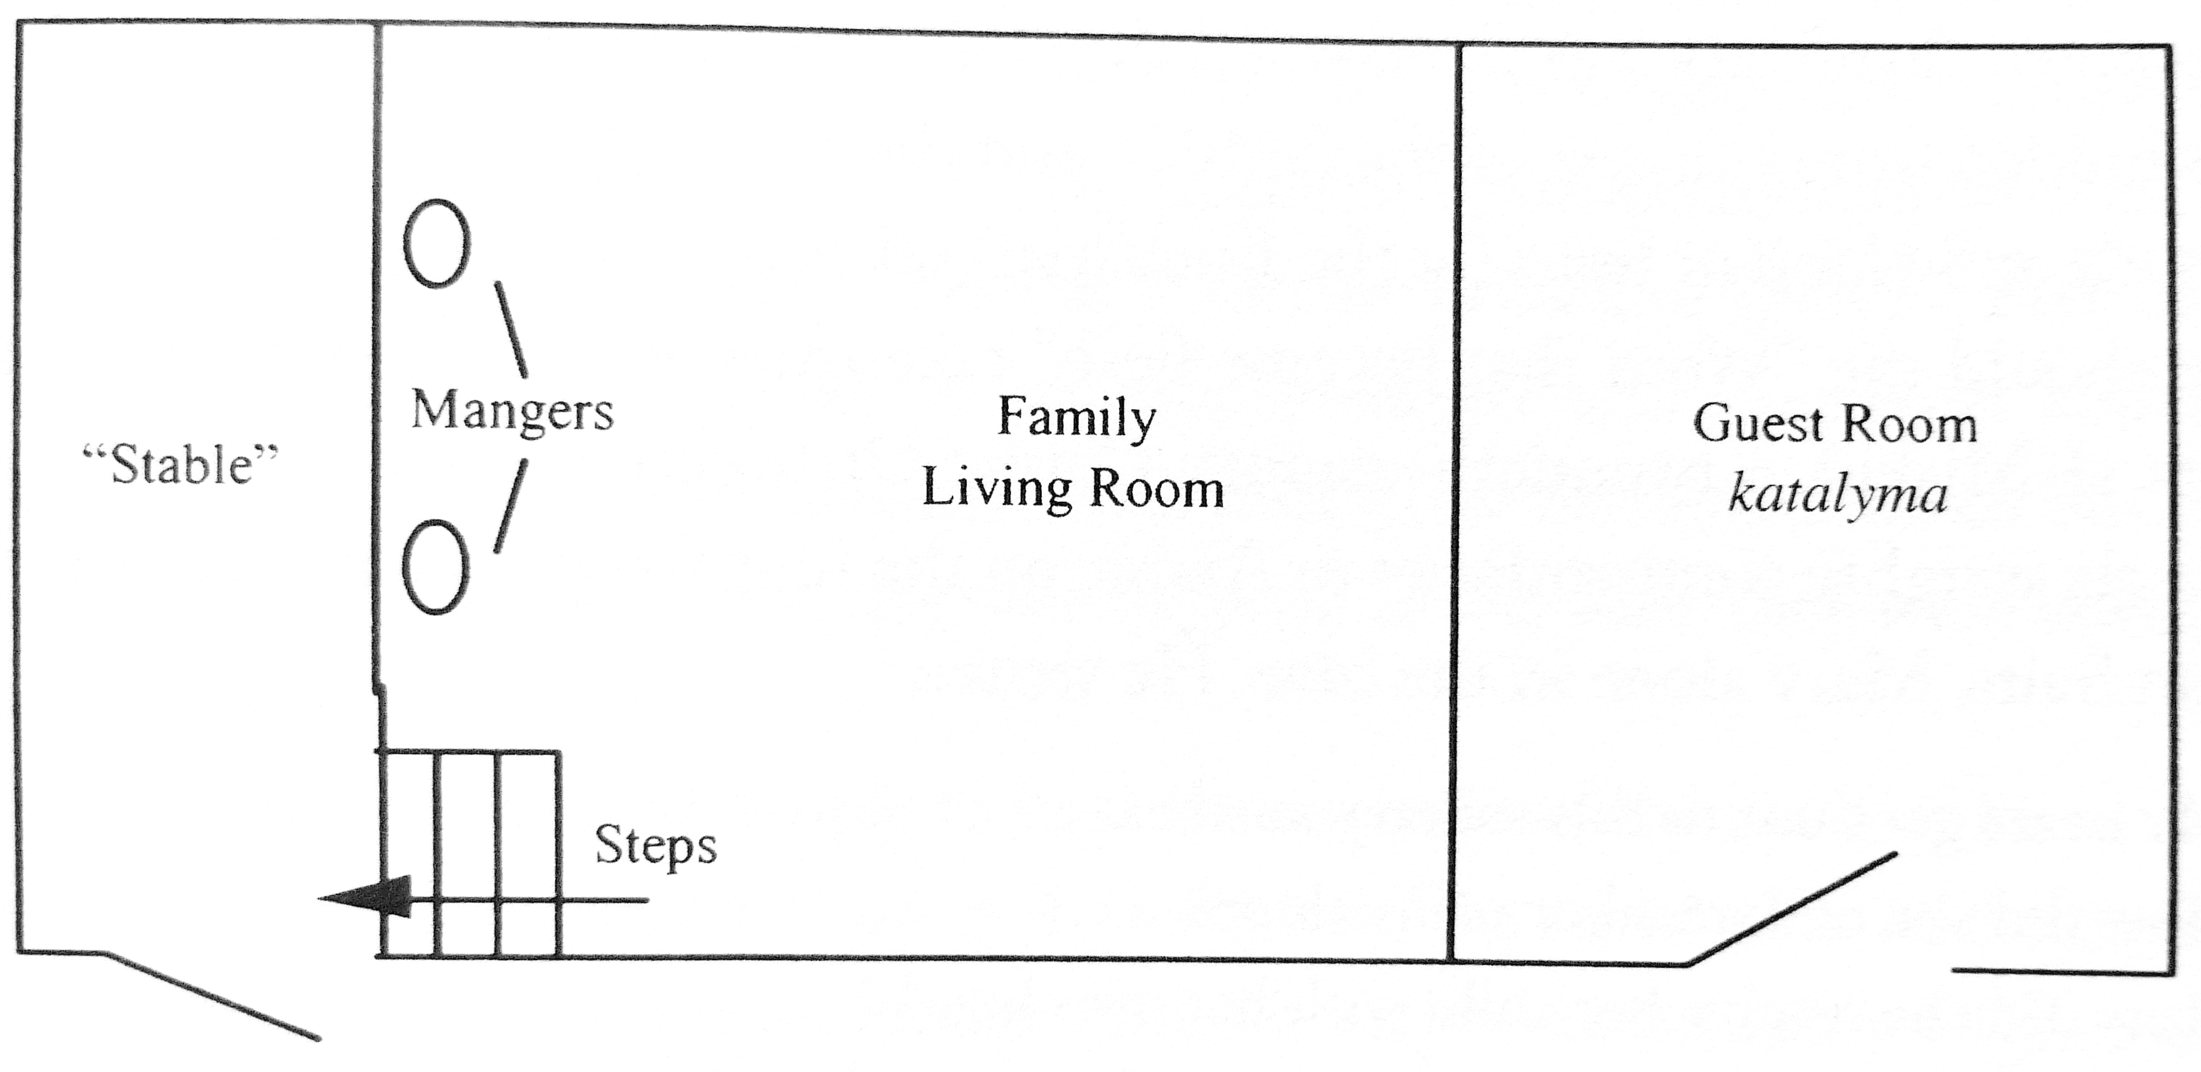
#8 Jesus was born in a barn/stable because there was no room in the Inn.

Slide 14
#8 Jesus was born in a barn/stable because there was no room in the Inn.
“To the Western mind the word manger invokes the words stable or barn. But in traditional Middle Eastern villages, this is not the case. People of great wealth would naturally have had separate quarters for animals. But simple village homes in Palestine often had two rooms.” – Kenneth Bailey

Slide 15
#9 The shepherds and wise men were present on the night Jesus was born.
False

Slide 16
#9 The shepherds and wise men were present on the night Jesus was born.
Luke 2: 15-16
Mathew 2:1-3/9-11
  The child (Paidion) not (Brefos) newborn
  The Magi were Astrologers and Astronomers
  Major astronomical things in the sky from 3BC to 2BC specifically from May to December (18 months)
  Jupiter was the star that moved over Bethlehem. Jupiter is called the “King Planet”.

Slide 17
#10 Jesus was born on December 25th.
False

Slide 18
#10 Jesus was born on December 25th.
All Bible Scholars agree it is not December 25th
Feast of Theophany – January 6th
  Moved to coincide with the Roman Holiday of the Sun God and birth of the Sun. Saturnalia
When was Jesus’ birth?
  “Shepherds out in the fields”
    After harvest, but before planting
    Could not have happened between November 1st thru July 1st
Ernest L. Martin believes it was September 11th 3BC.
  Revelation 12:1-6

Slide 19
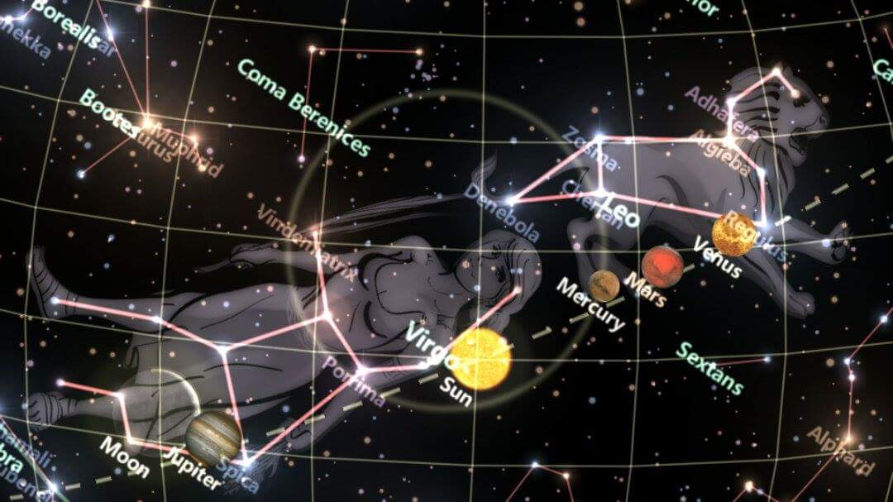
#10 Jesus was born on December 25th.

Slide 20
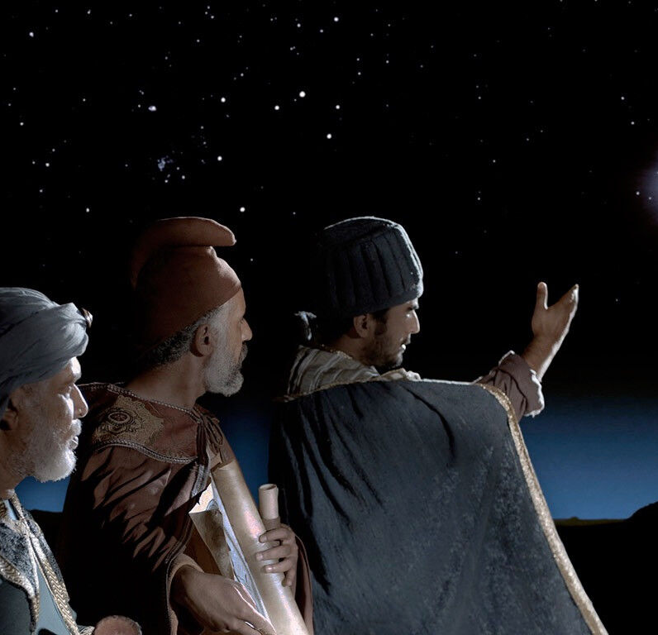
#10 Jesus was born on December 25th.
December 25th the day the Magi visited the Christ child and offered gifts.

