Slide 1
The Appointed Festivals of the LORD

Slide 2
The Seven Feasts
Passover
Unleavened Bread
First Fruits
Pentecost (Shavuot)
Trumpets
Day of Atonement
Feast of Tabernacles
Fall Feasts

Slide 3

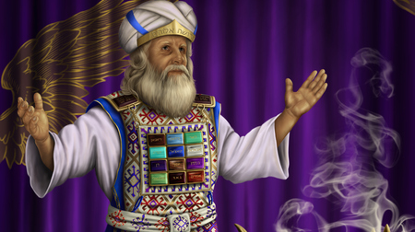

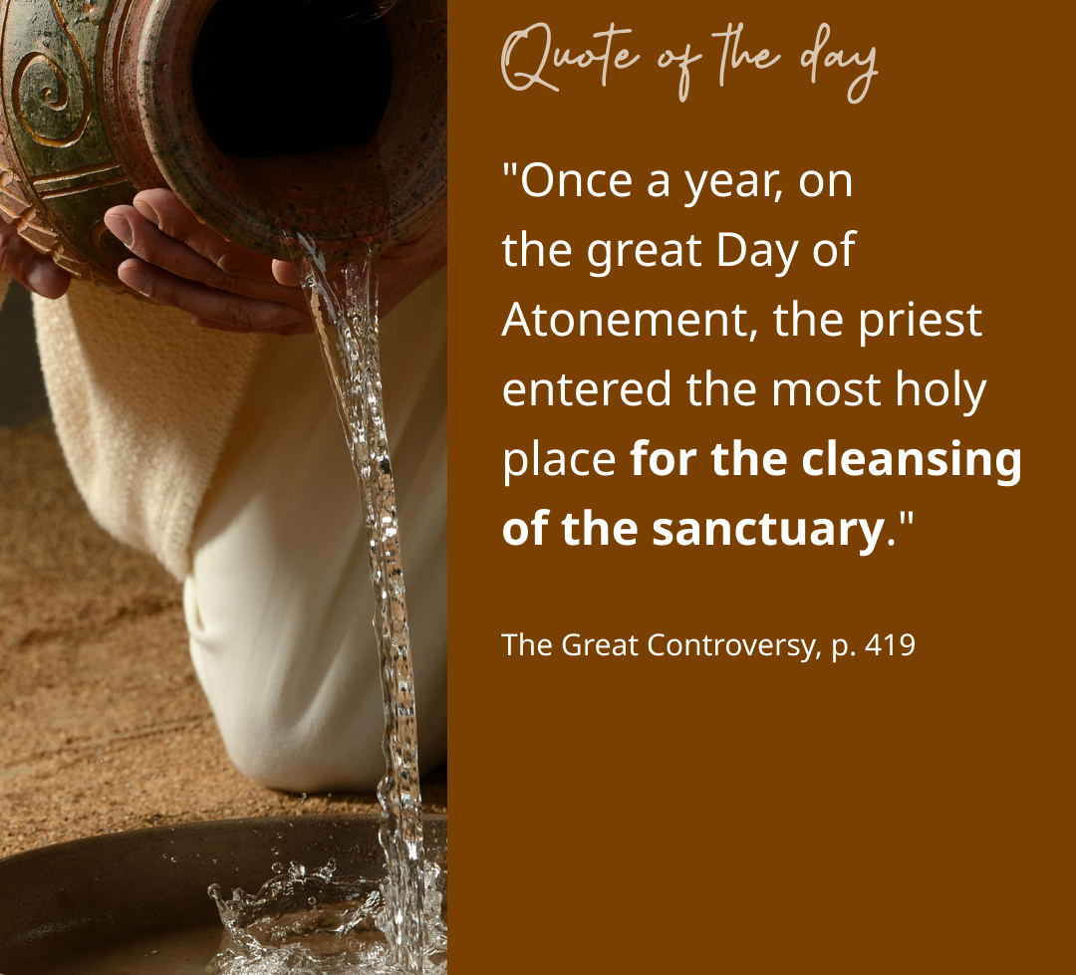
Day of Atonement

Slide 4
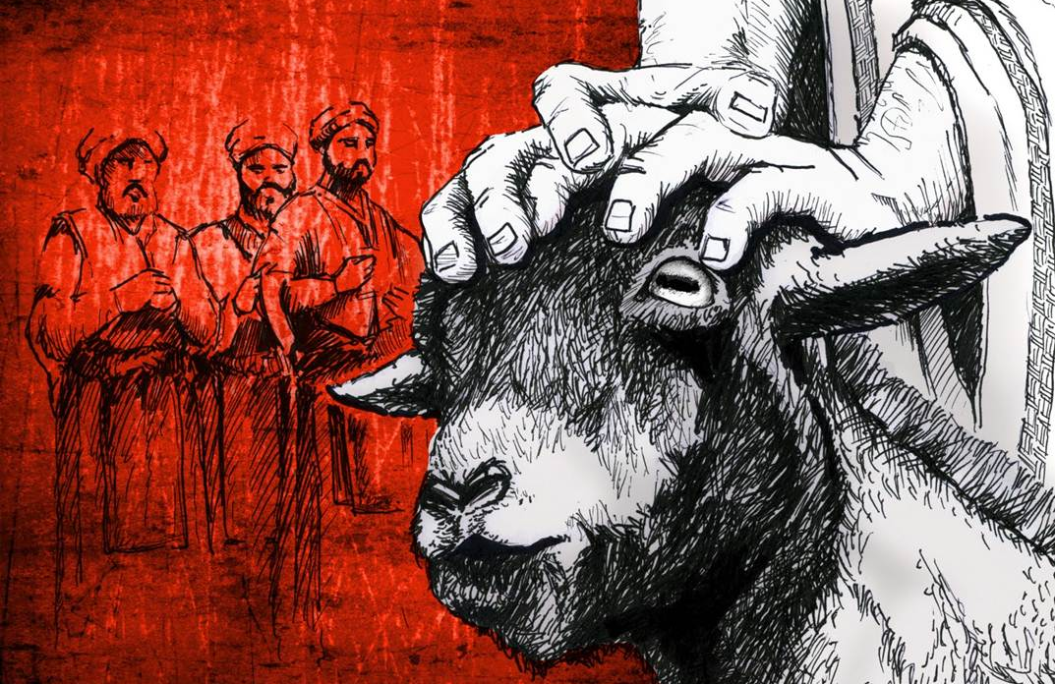
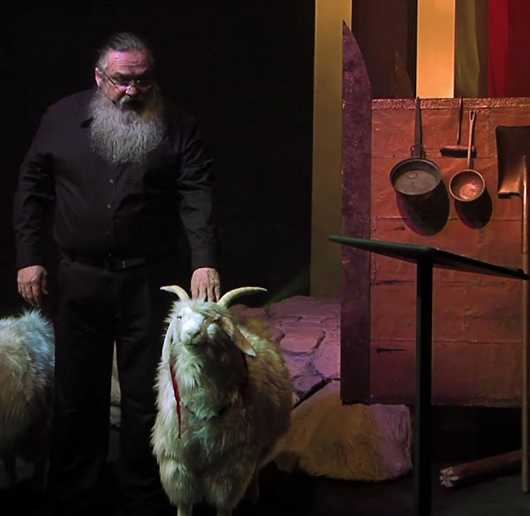
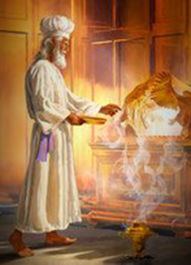
Day of Atonement
Lots for the 2 goats – For YAHWEH / For Az’Azel
AZ’AZEL – “the goat that was removed”
Ark of the Covenant
Shekinah Glory
AD30 to AD70

Slide 5

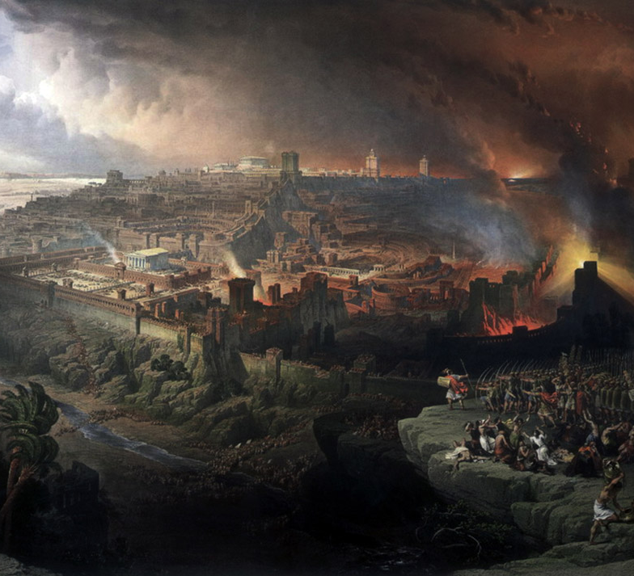
Day of Atonement
Anti- Type = Sacrifice of the innocent animals and the High Priest interceding for the people
ANTI-TYPE = The Christ
Yom Kippur Holiest day of the year
When?
Isaiah 63:1

Slide 6
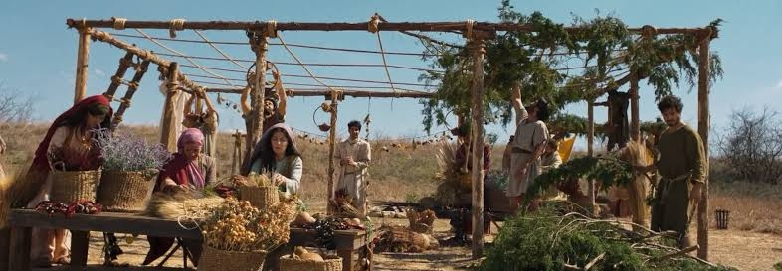
Feast of Tabernacle/Booths

Slide 7
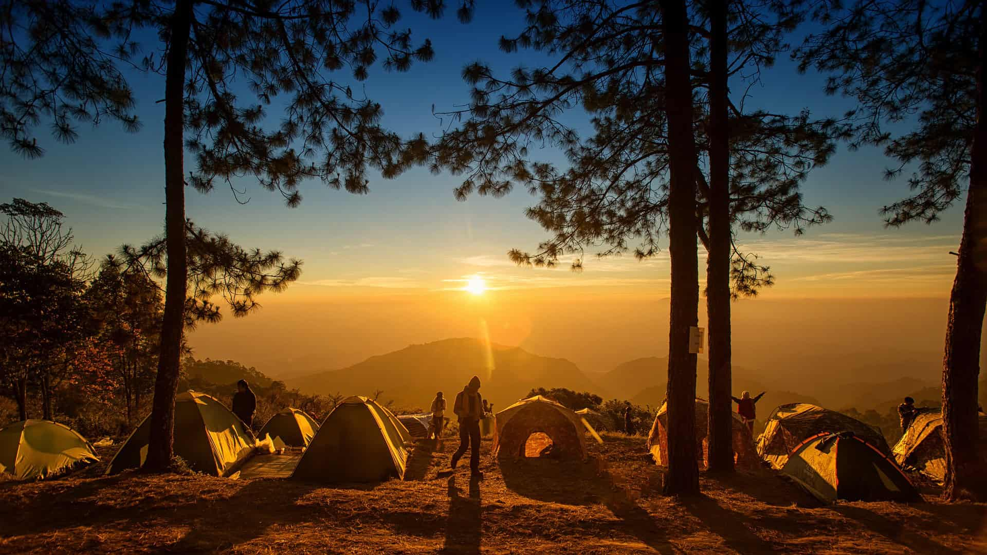
Tabernacle
Tabernaculum – Booth or Hut
Ingathering of the crops at harvest
Festival of Joy
Feast of Booths
Goyem & Place of the LORD’S choosing

Slide 8
Sacrifices
1 Goat/14 Lambs/2 Rams/13 Bulls decreasing by one each day after
70 Bulls. 70 Nations
Sacrifices 182/7 = 26
Meal Offerings 336/7 = 48

Slide 9
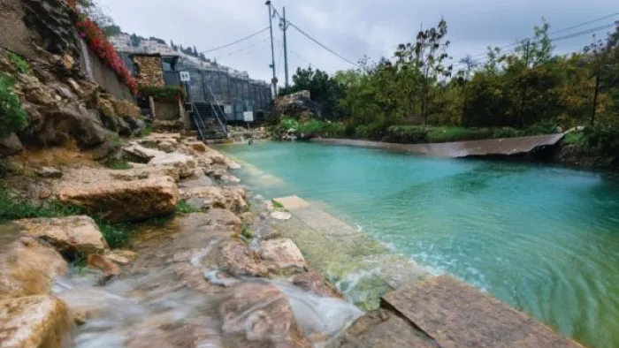
Pool of Siloam

Slide 10
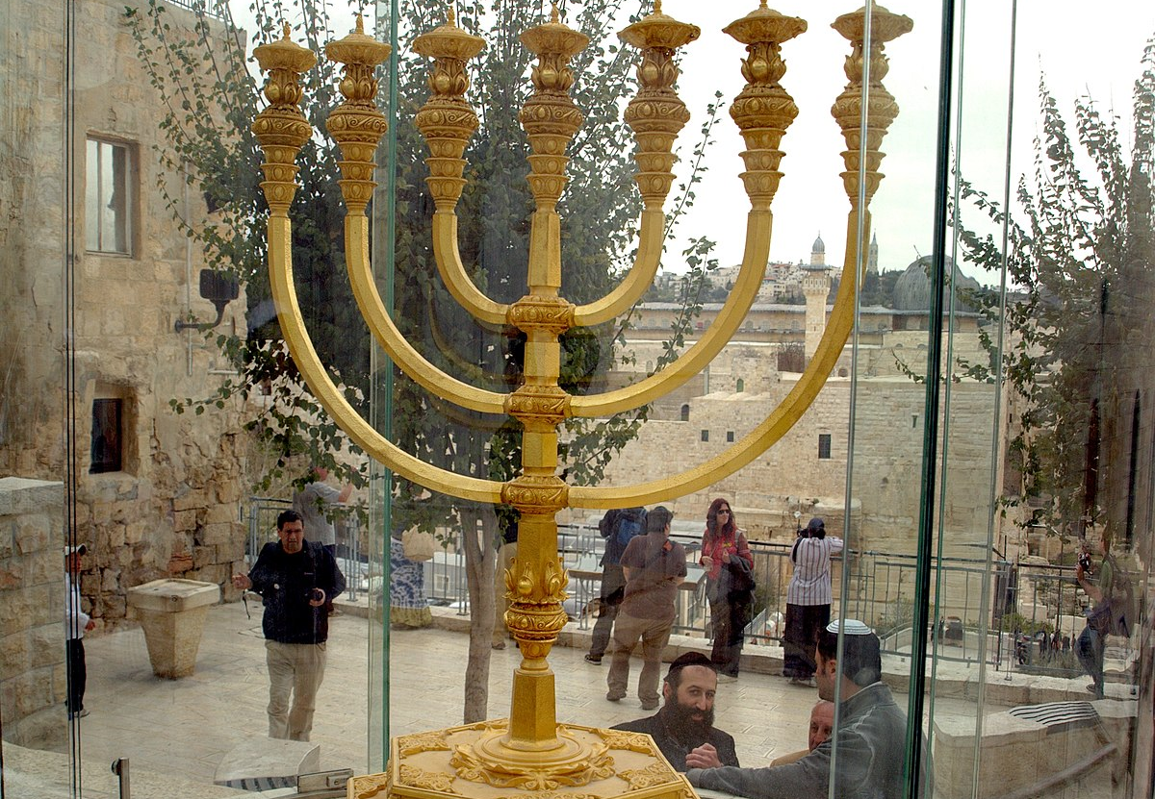

Menorah

Slide 11
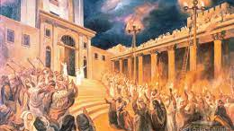
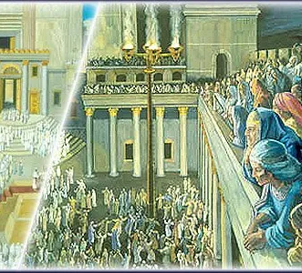
7th and Final Day

Slide 12
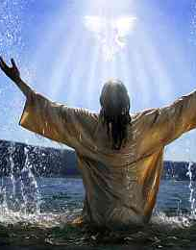
ANTI-TYPE
Living Water through which we receive eternal life
God brings the nations back to himself. The New Earth
New Jerusalem
Light of the World
His Bride and dwells with us without a Tabernacle or Temple
Holy Spirit opens our eyes to His truth

