Slide 1
The Appointed Festivals of the LORD
CrackABible.com

Slide 2
The Seven Feasts
Passover
Unleavened Bread
First Fruits
Pentecost (Shavuot)
Trumpets
Day of Atonement
Feast of Tabernacles
Spring Feasts
Fall Feasts

Slide 3
Holy Convocation
REHEARSAL
  Dress Rehearsal
God’s Prophetic Calendar
This is how God pointed Israel to their Messiah
The essence is Jesus

Slide 4



24 Hour Day
Hebrew Time was Sundown to Sundown
  6:00PM to 6:00PM – 1 Day
Morning – 6:00AM – 12:00PM
Evening – 12:00PM – 6:00PM
9th Hour Priest was to sacrifice the lamb
  MATT 27:46
PSALM 118:14
SALVATION

Slide 5
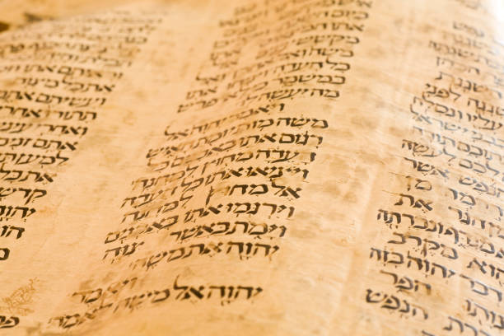
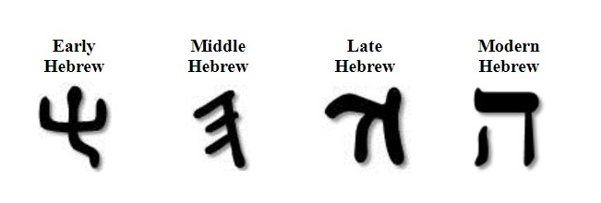
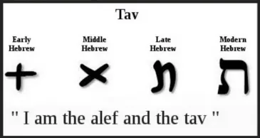
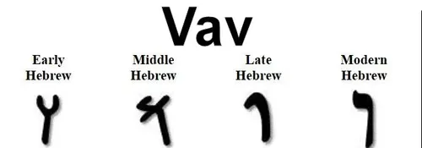
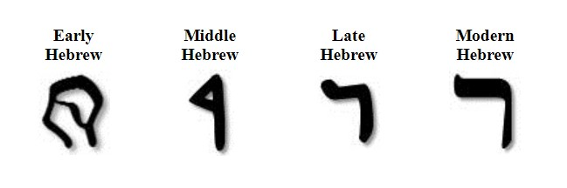
TORAH
TAV
VAV
RESH
HEY
“Revealing the highest person that is nailed to the cross.”

Slide 6
Feast of First Fruits
The Day After the Sabbath
  Between March and April
  Always fall on a Sunday
Jesus died on Passover A.D. 30 – On a Wednesday 14th of Nisan
3 Days in the ground just like the Prophet Jonah
Women Prepared Spices on Friday b/c Thursday was 15th of Nisan (Unleavened Bread) and it was a High Sabbath.
Passover 14th Nisan
Unleavened Bread 15th Nisan
High Sabbath – 7 Days
First Fruit on Sunday

Slide 7
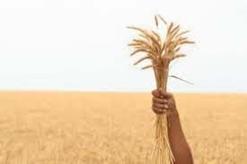
The Barley Harvest
First Sheaf is cut and presented to the LORD
The LORDS acceptance was a pledge
RE’SHIYTH – First, Chief, Choicest Part
People brought grain, 1 burnt offering, bread and wine
Nothing was to be harvested until the Priest finished with the waving
First Fruits is the shadow of Jesus Christ
The Type was the High Priest, and the Anti-Type is Christ

Slide 8
Pentecost/Shavuot
50 Days after First Fruits
30 + 20 = 50
Atzeret means Conclusion
Jews believe that God gave Moses the Law 50 days after First Fruits.
2 Loaves with leaven signify the 2 houses of Israel

Slide 9

Psalms40:7

