Slide 1
The Appointed Festivals of the LORD

Slide 2
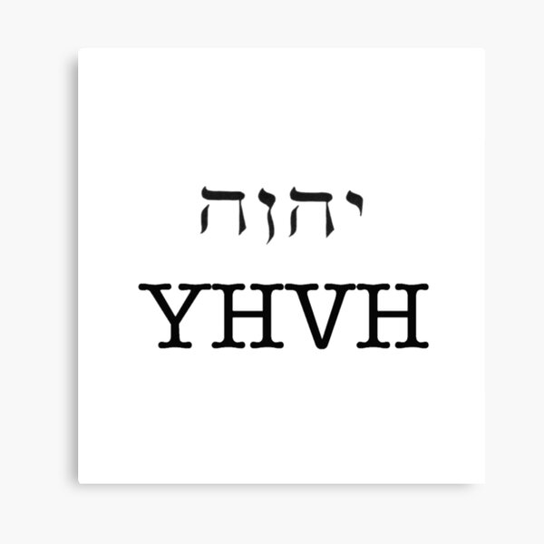
YAHWEH
The LORD
ADONAI

Slide 3
Jesus
Yehoshua/Yeshua
(God Saves)
Iesous

Slide 4
The Seven Feasts
Passover
Unleavened Bread
First Fruits
Pentecost
Trumpets
Day of Atonement
Feast of Tabernacles
Spring Feasts
Fall Feasts

Slide 5
Holy Convocation
REHEARSAL
  Dress Rehearsal
God’s Prophetic Calendar
This is how God pointed Israel to their Messiah
The essence is Jesus

Slide 6
Typology
TYPE
ANTI-TYPE
ADAM
CHRIST

Slide 7
The Passover
14th of Nisan was the first month in the Hebrew Calendar
  Between March and April
  God established after the exodus from Egypt
  Keep a 1-year-old lamb for 4 days starting on the 10th of Nisan

Slide 8

Passover

Slide 9
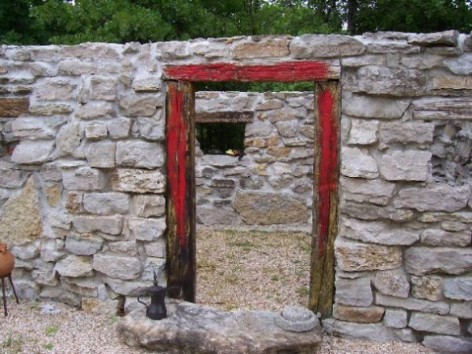

Slide 10



24 Hour Day
Hebrew Time was Sundown to Sundown
  6:00PM to 6:00PM – 1 Day
Morning – 6:00AM – 12:00PM
Evening – 12:00PM – 6:00PM
9th Hour Priest was to sacrifice the lamb
  MATT 27:46
PSALM 118:14
SALVATION

Slide 11
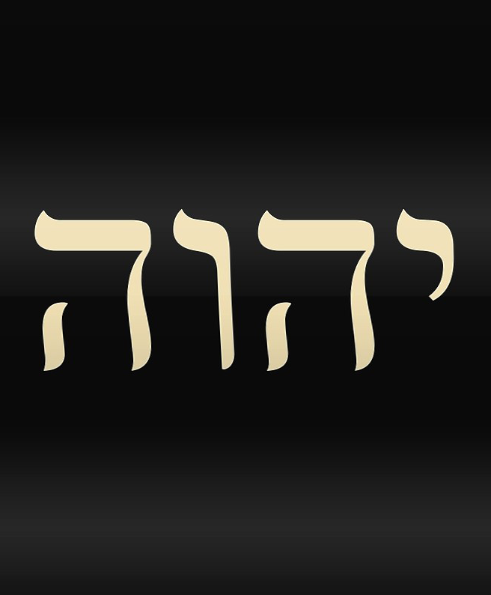
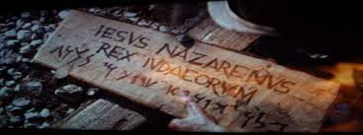
YHVH
HA YEHUDIM MELECH

Slide 12
The Passover
Sacrifice

Slide 13
The Feast of Unleavened Bread
15th of Nisan was the first month in the Hebrew Calendar
  Between March and April
  It starts at 6:00PM
  Special Sacrifices every day
  No work was to be performed (High Sabbath) on the First and Seventh Day
  No leaven was to be eaten, kept in the house or hidden away

Slide 14
The Feast of Unleavened Bread
Deliverance

Slide 15
Typology
ANTI-TYPE
CHRIST

