Slide 1
The Appointed Festivals of the LORD

Slide 2
Feast of First Fruits
The Day After the Sabbath
  Between March and April
  Always fall on a Sunday
Jesus died on Passover A.D. 30 – On a Wednesday 14th of Nisan
3 Days & 3 Nights in the ground just like the Prophet Jonah
Women Prepared Spices on Friday b/c Thursday was 15th of Nisan (Unleavened Bread) and it was a High Sabbath.
Passover 14th Nisan
Unleavened Bread 15th Nisan
High Sabbath – 7 Days
First Fruit on Sunday

Slide 3


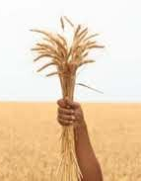
The Barley Harvest
First Sheaf is cut and presented to the LORD
The LORDS acceptance was a pledge
Nothing was to be harvested until the Priest finished with the waving
First Fruits is the shadow of Jesus Christ
The best was resurrected first then the Saints. Matt 27:50-53
The Type was the High Priest, and the Anti-Type is Christ

Slide 4
Pentecost/Shavuot
50 Days after First Fruits
30 + 20 = 50
Atzeret means Conclusion
Jews believe that God gave Moses the Law 50 days after First Fruits.
2 Loaves with leaven signify the 2 houses of Israel
Psalms 40:7

Slide 5
The Seven Feasts
Passover
Unleavened Bread
First Fruits
Pentecost (Shavuot)
Trumpets
Day of Atonement
Feast of Tabernacles
Fall Feasts

Slide 6
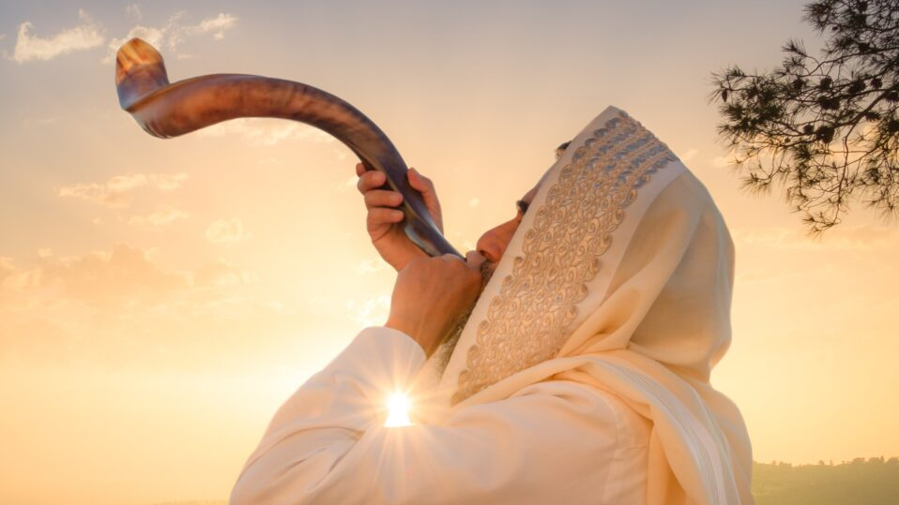
The Feast of Trumpets
Observe a rest, blow trumpets and then present a food offering
Holy Convocation - REHEARSAL
Yom Teruah – The Day of Blowing Trumpets
Hebrews were on a Lunar Calendar
New Moon and the Night Sky

Slide 7
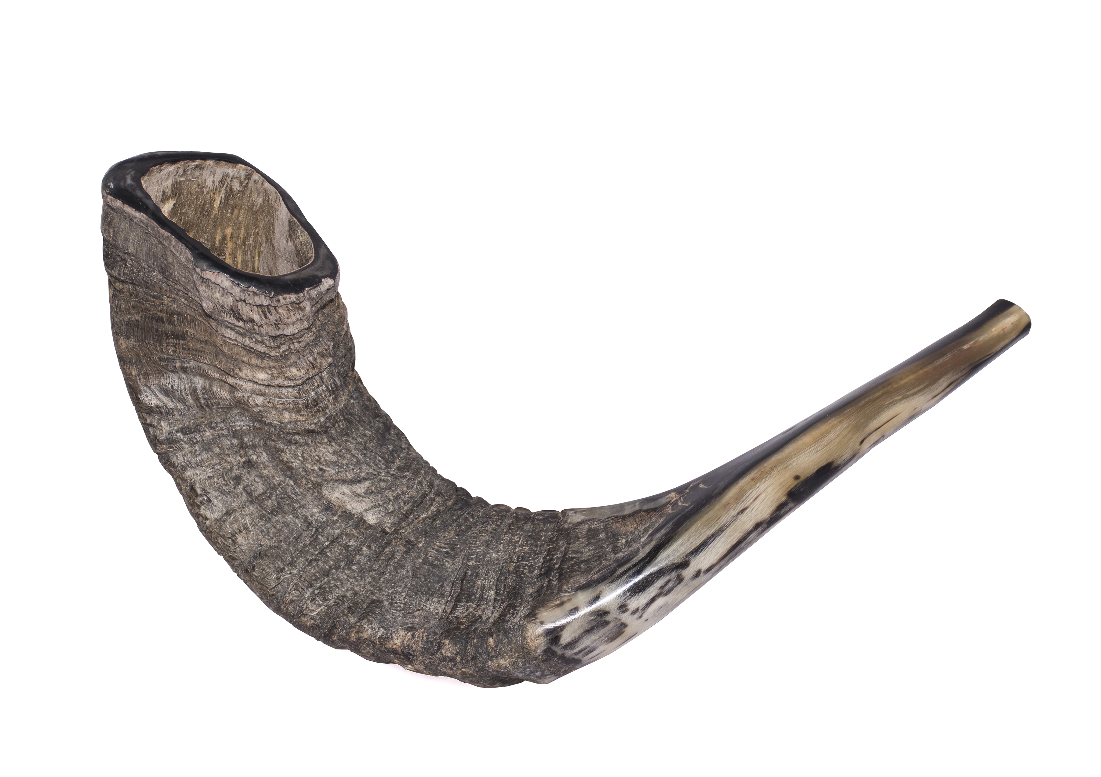
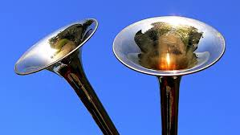
The Feast of Trumpets
2 Types of Trumpets – Silver Trumpets and a Ram’s horn called the Shofar

Slide 8
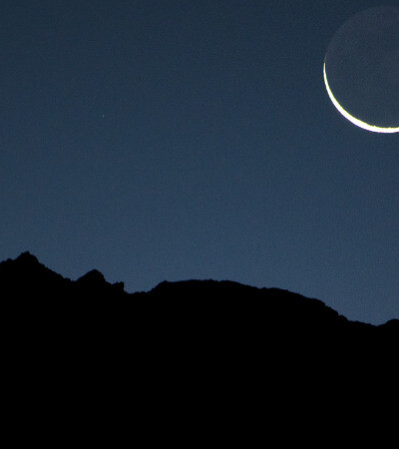
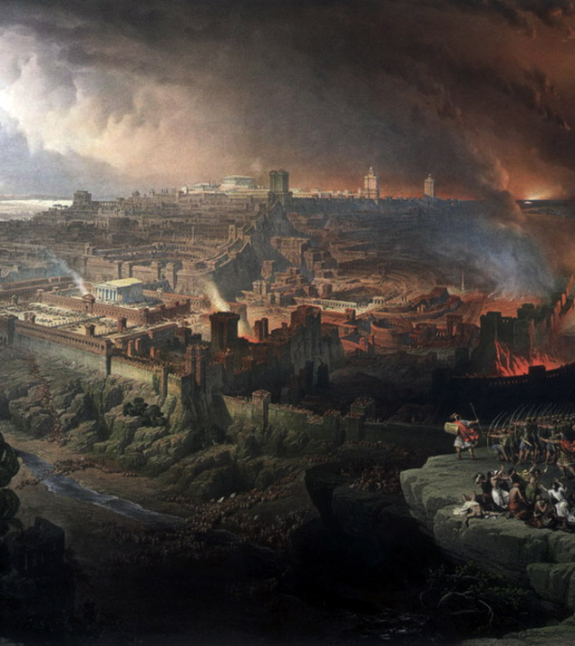
Resurrection/Israel’s Dark Day
Calling together the Elect from the 4 winds
The Day of the LORD
Coming Judgment

